Slide 1

S-211 Introduction to Weather & The Fire Environment
For Firefighters and Dispatchers
Part 1

Slide 2
Disclaimer
This presentation is prepared for the sole use of British Columbia Wildfire Service personnel and authorized standing offer contract holders. It may not be used by other agencies or individuals as a development guideline without the express written permission and cooperation of the British Columbia Ministry of Forests, Lands and Natural Resource Operations and Rural Development.

Slide 3
Introduction
Anyone whose work involves wildland fire needs to be acutely aware of the weather and its influence upon fire behaviour. Within a short period of time weather conditions can change dramatically, and consequently the way a fire behaves can also change dramatically. Wildland fire is also capable of creating its own weather conditions. Without a rudimentary knowledge of weather processes, fire behaviour and the relationship between them the wildland fire fighter will find himself or herself at a disadvantage in their work.

Slide 4
Introduction
How a wildland fire burns is dependent upon three variables: topography, fuel and weather. These three variables together form the wildland fire triangle. Weather conditions can change rapidly, the worker needs to know not only what the current weather conditions are, but also what weather conditions are likely to occur in the immediate future, so that he or she is able to predict how a fire will behave and act accordingly.

Slide 5
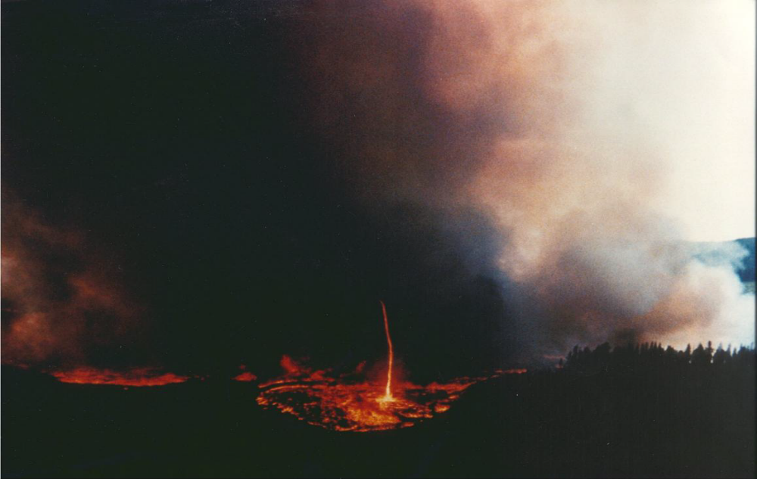
Upon completion of this unit the student will:
Understand the link between weather and fire behavior
Understand the link between weather and crew safety
Understand and use weather instruments & Belt Weather Kits
Be able to observe and report weather conditions
Understand the Fire Weather Forecast, its use and its limitations
Notes:
Ensure the students know what they will have learned by the end of this course/module

Slide 6
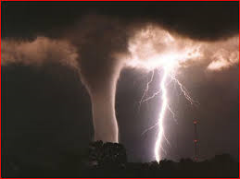
Part 1
WEATHER ELEMENTS
Notes:
Put instructor notes here

Slide 7
Temperature
Is the hotness or coldness of the atmosphere.
Effects the ease of ignition by preheating the forest fuels.
Effects the drying cycle and therefore flammability of the forest fuels. The warmer the temperature the faster the fuels dry due to evaporation of forest fuels.
Directly affects the firefighters comfort. Too cool and hypothermia becomes a concern, too hot and dehydration becomes a problem.
Has a daily variation, coolest near daybreak and warmest during the late afternoon and early evening, therefore producing the most active fire behavior during the late afternoon and evening.

Slide 8
Temperature
Has a seasonal variation, coolest in winter when daylight is limited and warmest during summer when daylight hours are longest, therefore producing a longer burning period during the summer months.
Has great variation due altitude, forest cover, terrain aspect. Normally warmest in the valley bottoms and on South facing slopes. Coolest in the mountains and on North facing slopes. Cooler under the closed forest canopy.
Normally decreases with altitude.
Can increase with altitude, nighttime inversion, producing a thermal layer near the top of the inversion where fire behavior can remain active through the night.

Slide 9
Relative Humidity
Percent of moisture in the atmosphere.
Effects the drying cycle of the fine and medium fuels by allowing moisture to evaporate into the atmosphere. The lower the relative humidity, the faster the fuels dry.
Effects fire behavior. The lower the relative humidity the more active the fire behavior.
May add moisture to the forest fuels when high.

Slide 10
Relative Humidity
Has a daily variation, lowest in the late afternoon and early evening, and highest near daybreak. This produces the most active fire behavior during the late afternoons and early evenings.
Has a seasonal variation, higher, longer during the winter months and lower, longer during the summer months.
Has great variation due altitude, forest cover, terrain aspect. Lowest in the valley bottoms and on South facing slopes. Highest in the mountains and on North facing slopes. Higher under the closed forest canopy.
Normally increases with altitude. Can decrease with altitude, nighttime inversion, producing a thermal layer near the top of the inversion where fire behavior can remain active through the night.

Slide 11
Wind Speed
Effects the drying of the fine and medium fuels by transporting moisture away from these fuels. Strong wind produces increased drying.
Effects fire spread rates and therefore fire behavior by producing longer, tilted flame lengths which preheat fuels in advance of the flame front. The stronger the wind speeds the greater the spread rates and more active fire behavior.
Effects fire behavior by replacing the oxygen used in the combustion process leading to more active fire behavior.
Effects firefighter safety. Strong winds cause blow-down of snags and trees and produce flying debris. Increasing or strong winds can lead to the fire overrunning firefighters.

Slide 12
Wind Speed
Effects firefighter comfort. Strong winds and cool temperatures lead to an increasing chance of hypothermia. Strong winds and hot temperatures increase the chances of dehydration.
Has a daily variation, thermal wind. Calmest near daybreak and strongest during the late afternoon and early evening. Heating of the earth's surface produces updrafts and downdrafts which lead to gusty late afternoon and early evening winds leading to erratic spread rates, erratic spread directions and spotting.
Normally increases with height.
Increases with valley narrowing.

Slide 13
Wind Direction
Blows from high pressure to low pressure
Blows from cold to hot.
Effects fire spread direction
Effects firefighter safety. Changing wind direction can lead to trapped firefighters.
Veers during the day and backs at night.

Slide 14
Wind Direction
Is upvalley/upslope during daylight hours and downvalley/downslope at night
Veers with height.
Tends to follow the valleys.
Is onshore during the day and offshore at night.

Slide 15
Precipitation
Has several states which depend on temperature and the stability of the atmosphere. Rain, drizzle, snow, ice pellets, snow pellets, hail, showers can all occur during the fire season.
Effects fire starts. Lack of precipitation over an extended period leads to drier fuels and an increased chance of ignition while moderate to heavy precipitation and extended precipitation will limit the chance of ignition.
Effects fire behavior. An extended period of no precipitation.

Slide 16
Precipitation
Effects firefighter safety. Moderate to heavy precipitation and extended periods of precipitation will lead to lower temperatures and an increased chance of hypothermia. It will also lead to poor footing and decreased grip.
Has seasonal variations. Precipitation producing storms are more active in the spring and fall.
Has diurnal variations. During summer months afternoon showers are most common.

Slide 17
Air Mass Stability and Instability
Stability of the air mass refers to the tendency of a parcel of air when it is lifted to either continue rising or sink back to its original level. Although air mass stability is not a primary element of fire weather, knowledge of cloud formation and weather as well as knowledge of fire behaviour rely on an understanding of the concept.

Slide 18
Air Mass Stability and Instability
A parcel of air can be lifted in several ways:
Heating from below making the parcel more buoyant
Cooling from above making the parcel more buoyant
Air converging in a low pressure system forcing air upward
Forced upward by topographic features such as mountains
Advancing front pushing cooler air under warmer air lifting the warmer air
A lifted parcel of air may:
Continue rising, or
Sink back to its original level

Slide 19
Air Mass Stability and Instability
A parcel that continues rising is called unstable
Is warmer than the surrounding air
Fire behaviour is more intense in an unstable air mass
A parcel that sinks back to its original level is called stable
Is cooler than the surrounding air
Fire behaviour is less intense in a stable air mass
The air mass in a high pressure system is generally stable and the air mass in a low pressure system tends to be unstable

Slide 20
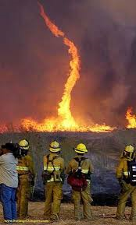
Questions?

Slide 21
S-211 Introduction to Weather & The Fire Environment
For Firefighters and Dispatchers
Part 2

Slide 22
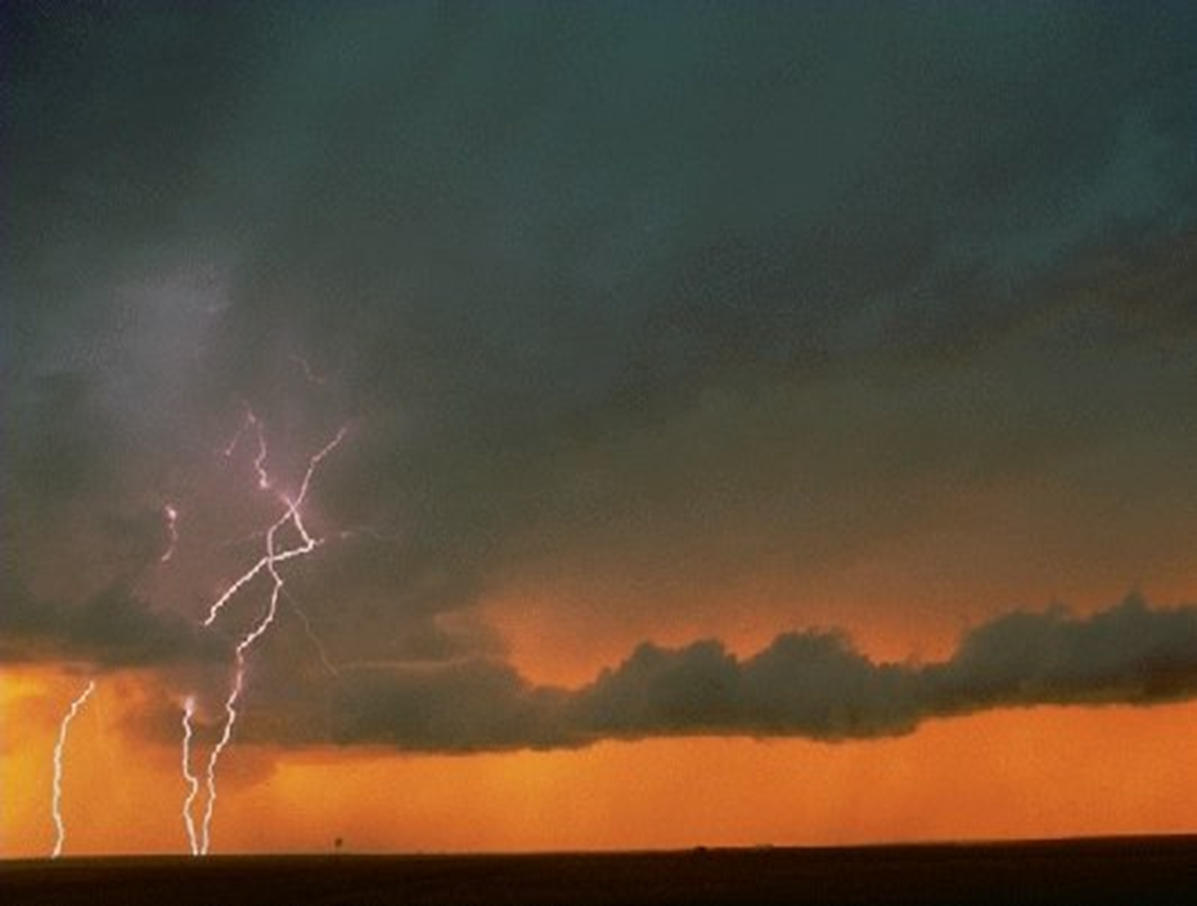
Observing the Weather
Cloud Types and Associated Weather
Notes:
Clouds are formed by certain processes which lift a parcel of air. We noted these lifting processes in the previous section on air mass stability. As the parcel is lifted the air in the parcel cools to the point where the moisture in the parcel condenses and forms a visible cloud. At this point precipitation may start falling from the saturated cloud.
Classification of clouds can be by the height above ground at which they form, the levels being high, middle and low, and by whether they are cumuliform or stratoform. Cumuliform clouds normally have vertical development greater than the horizontal area, whereas stratoform clouds have little vertical development compared to the horizontal area. Some clouds may exhibit characteristics of both forms. The type of cloud can give an indication of atmospheric processes at work and therefore what weather conditions to expect in the near future. A stratoform cloud is formed by lifting stable air, and cumuliform cloud is formed by lifting unstable air.

Slide 23
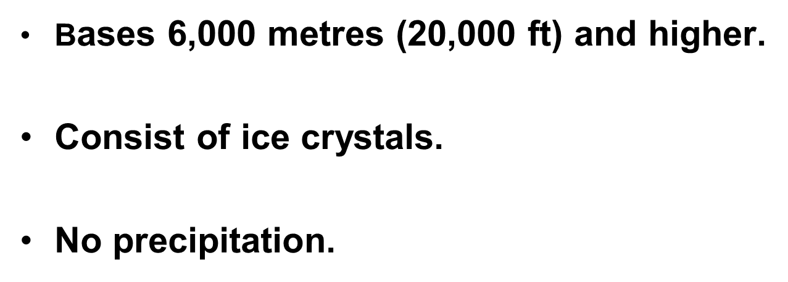
High Cloud

Slide 24
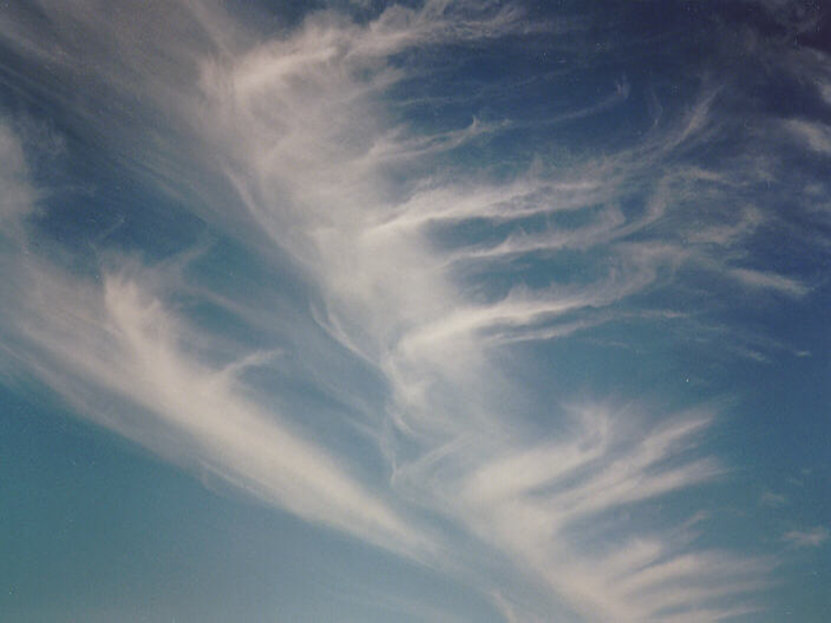
Cirrus
Notes:
Wispy thin clouds often called mare's tails. Usually fair weather but can be indicative of an approaching warm front a couple of days off or a jet stream overhead.

Slide 25
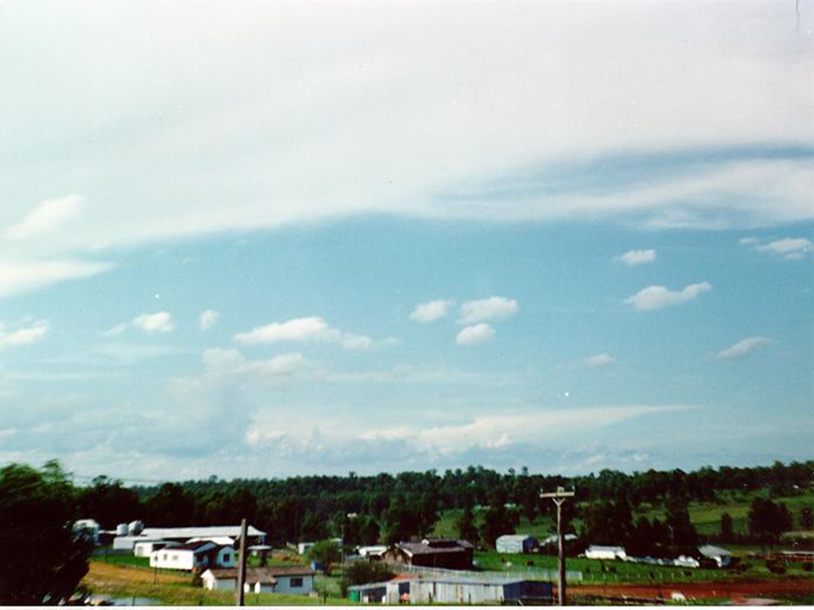
Cirrostratus
Notes:
Thin blanket of cloud with the sun visible and often a halo around the sun. First indication of an approaching warm front, forerunner of precipitation in the next 18 to 30 hours.

Slide 26
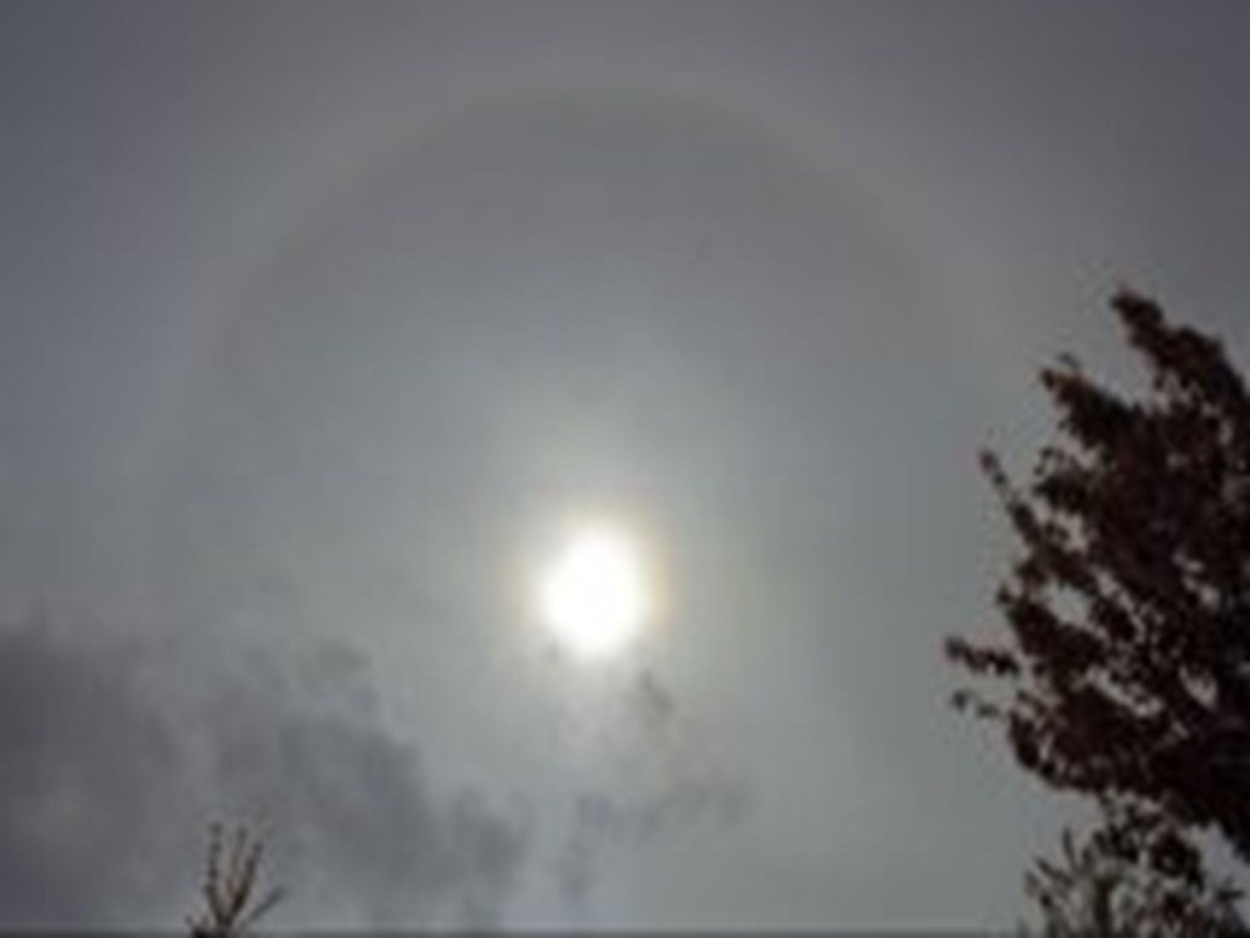
Cirrostratus
Notes:
Thin blanket of cloud with the sun visible and often a halo around the sun. First indication of an approaching warm front, forerunner of precipitation in the next 18 to 30 hours

Slide 27
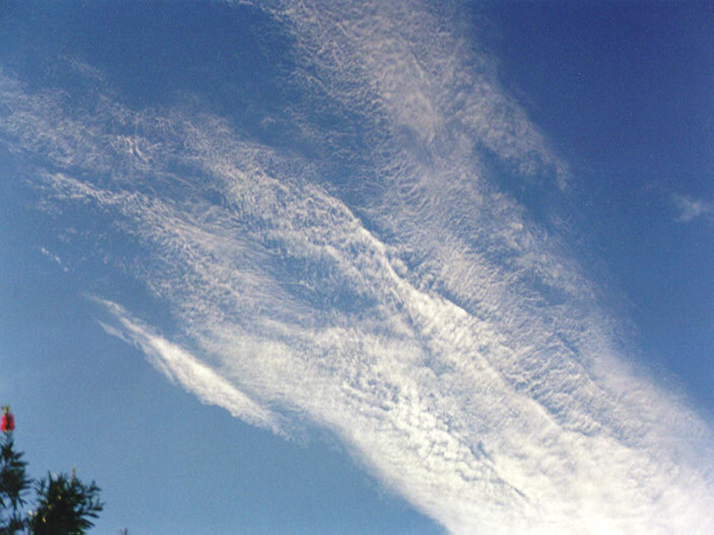
Cirrocumulus
Notes:
Sheets or bands of small white flakes or very small globular masses, may look like ripples in the sand on the seashore. Unstable air, often a forerunner of thunderstorms later in the day. Virga possible. Virga is an observable streak or shaft of precipitation falling from a cloud that evaporates or sublimates before reaching the ground.

Slide 28
Mid Cloud
Bases 2,000 to 6,000 metres (6,500 to 20,000 feet).
Consist of water droplets, super cooled water
Droplets and ice crystals.
No precipitation or light precipitation

Slide 29
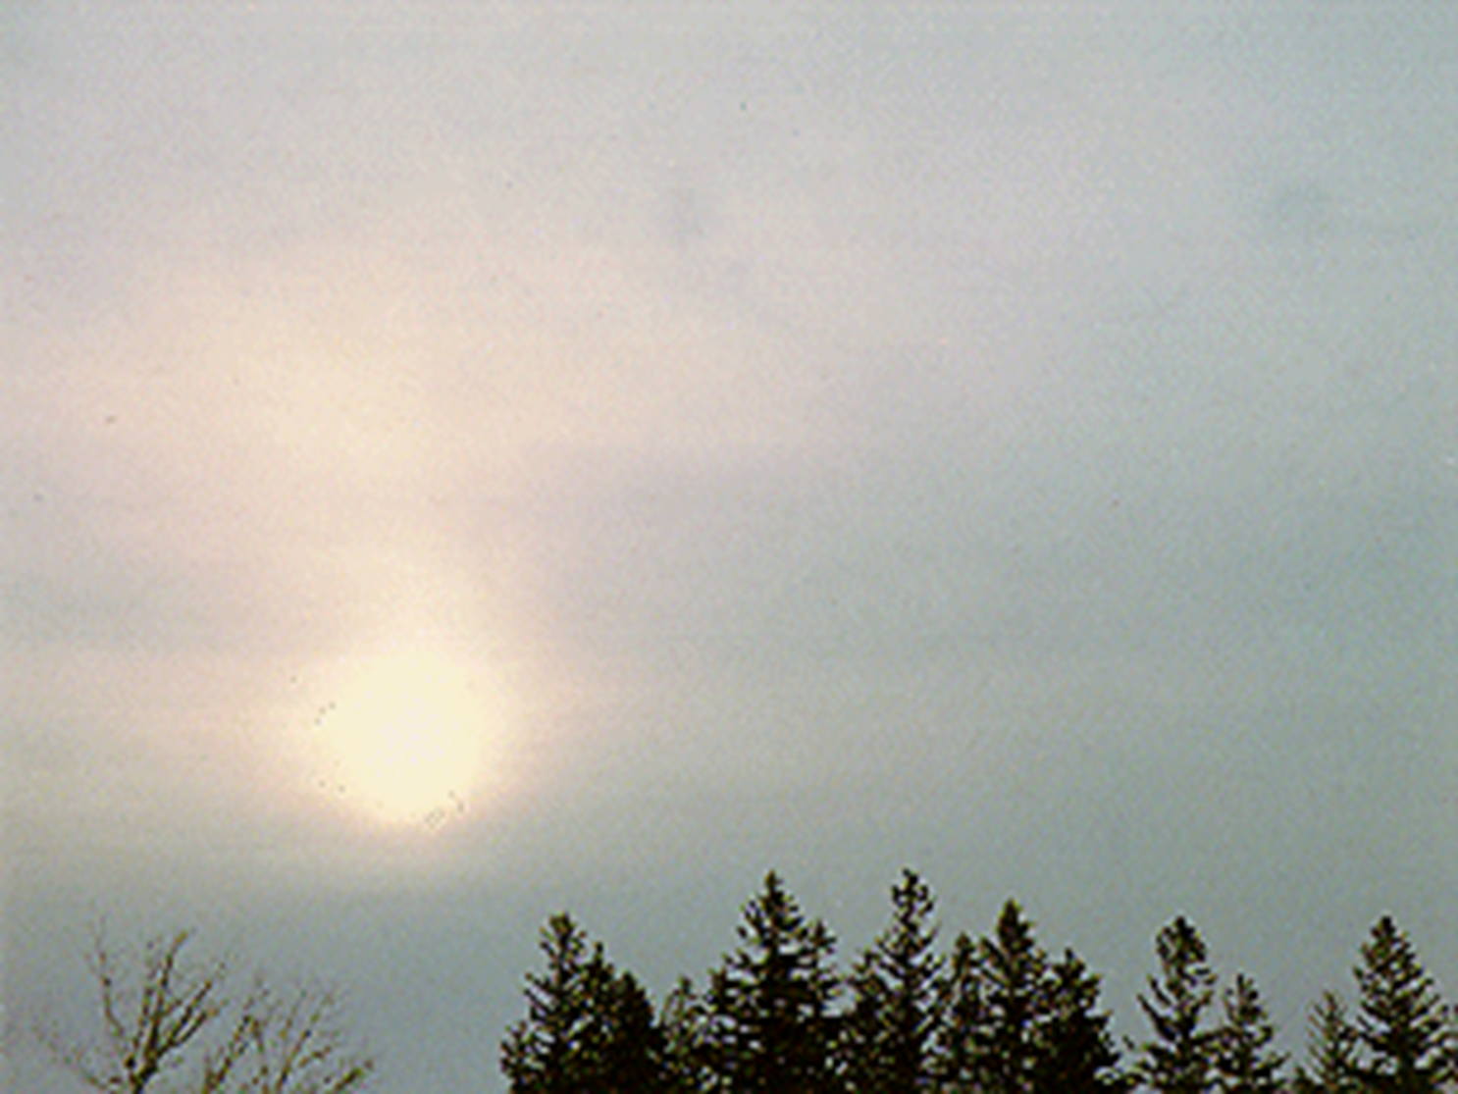
Altostratus
Notes:
Grayish sheet or blanket of cloud with the sun dimly visible or invisible, no halo. Stable air, pre warm front with light rain or virga associated.

Slide 30
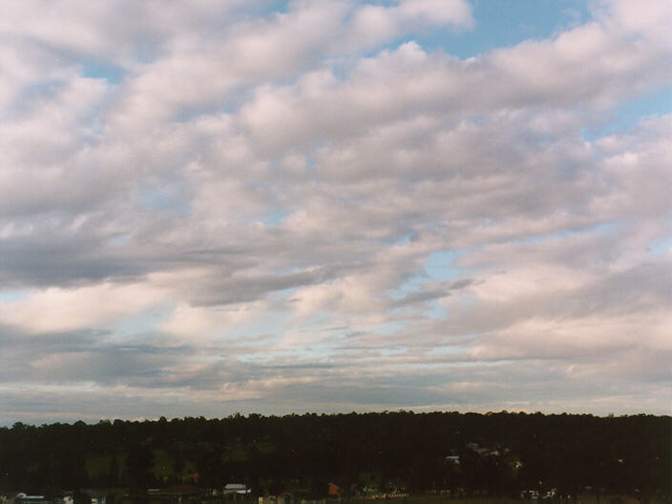
Altocumulus
Notes:
Patches, bands or sheets with a rounded or rolled shape appearance, globular masses. Unstable air with very light showers or virga possible. May be frontal, pre or post frontal or associated with an upper trough.

Slide 31
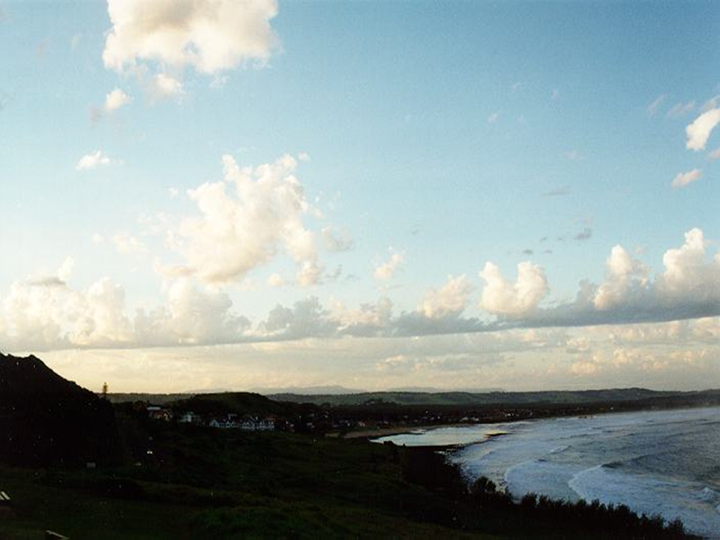
Altocumulus Castellanus
Notes:
Individual tower like cells. Unstable air mass, thunderstorms often develop later in the day. May be frontal, pre or post frontal, associated with an upper trough or unstable air mass. Light rain shower or virga possible.

Slide 32
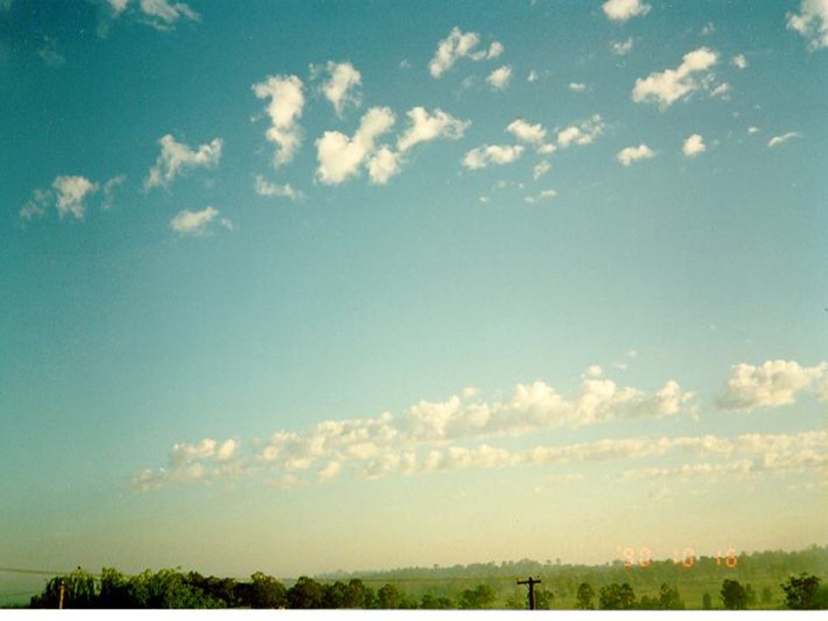
Altocumulus Floccus
Notes:
Puffy white clouds looking like cotton balls. Unstable air mass, thunderstorms often develop later in the day.

Slide 33
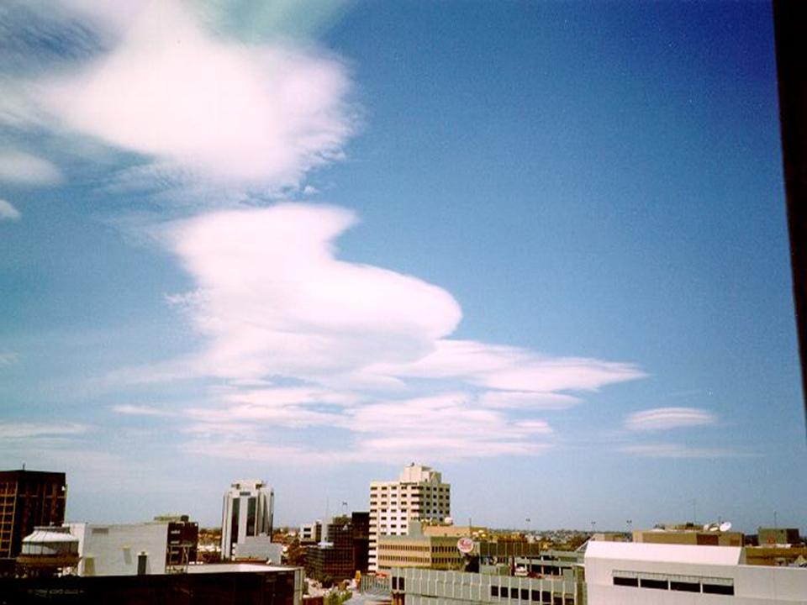
Altocumulus Lenticular
Notes:
Lens or almond shaped cloud generally on the lee side of mountain ranges. Indicator of strong high level winds. No precipitation.

Slide 34
Low Cloud
Bases surface to 2,000 metres (6,500 ft.)
Cumulus bases may range as high as 4,500 metres (15,000 feet) during the summer months.
Consist of water droplets or super cooled
water droplets with ice crystals in the higher areas of the clouds.
Precipitation may be light, moderate or heavy.
Notes:
Bases usually from the surface to 2,000 metres (6,500 feet),consist of water droplets or super cooled water droplets and ice crystals in the towering clouds. During the summer months cumulus cloud bases may range as high as 4,500 metres (15,000 feet). Cumulus clouds are also referred to as clouds of vertical development.

Slide 35
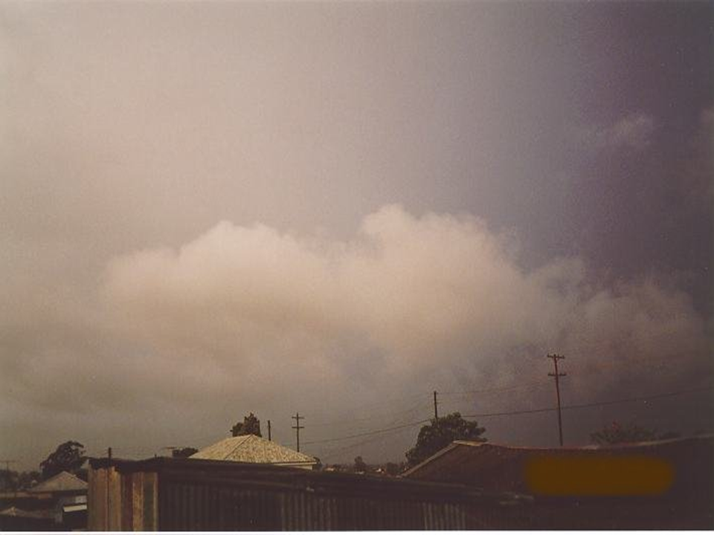
Strato Fractus
Notes:
Fragmented wispy clouds, form in precipitation. Stable air.

Slide 36
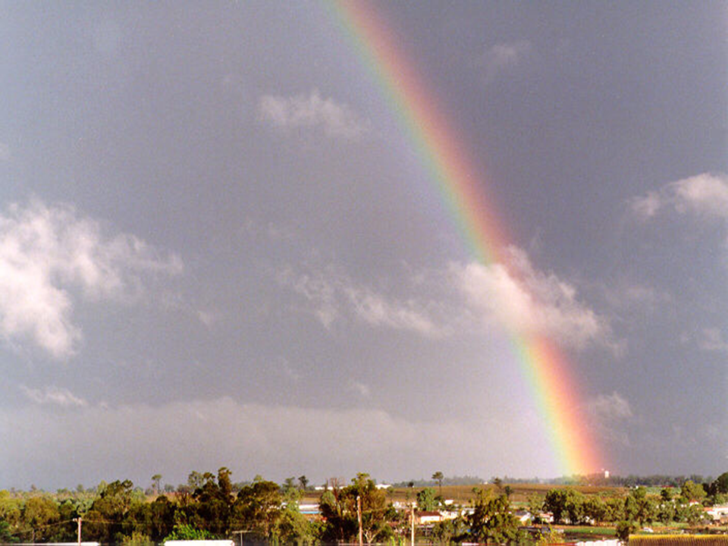
Cumulo Fractus
Notes:
Fragmented wispy clouds, form in precipitation. Unstable air.

Slide 37
Stratus
Notes:
Low, uniform layer of cloud. Stable air mass, may produce drizzle with no appreciable accumulation.

Slide 38
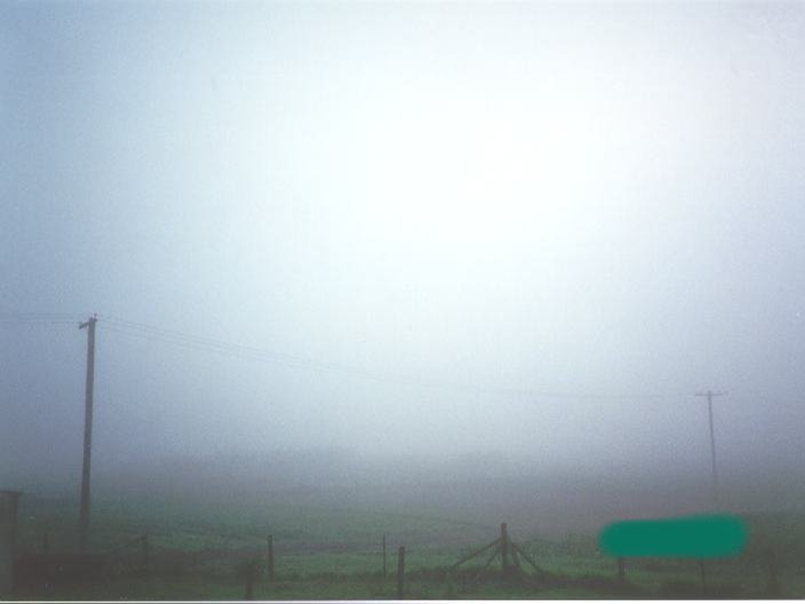
Fog
Notes:
Thin, gray layer of cloud whose base is touching the ground. Stable air mass, may produce drizzle with no appreciable accumulation.

Slide 39
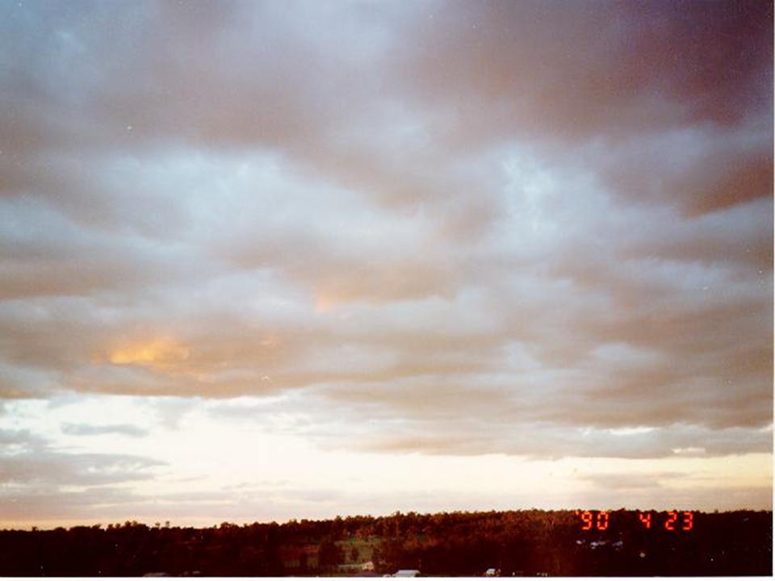
Stratocumulus
Notes:
Bands, sheets or patches of cloud with a rounded or rolled shaped appearance. May be frontal, pre or post frontal or associated with an upper trough.May produce light rain or light drizzle.

Slide 40
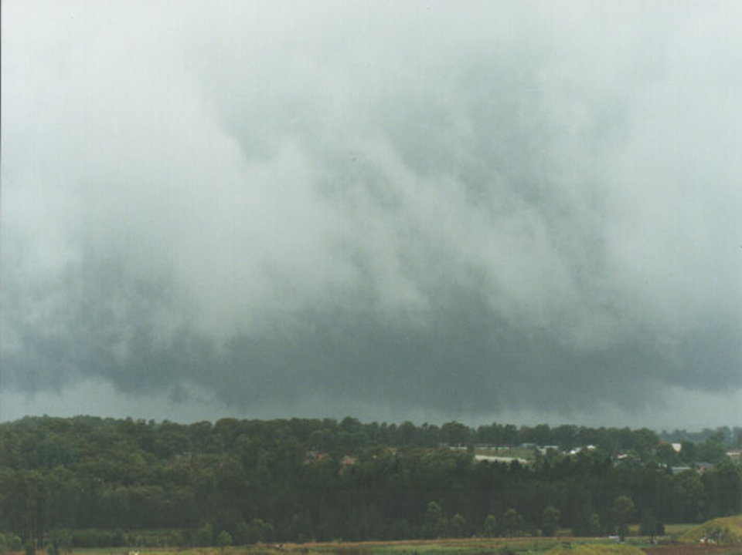
Nimbostratus
Notes:
Dark gray cloud covers the entire sky and blocks out the sun. Stable air. Warm frontal cloud with continuous rain, which may be light, moderate or heavy in intensity. Thunderstorms are sometimes embedded if air mass unstable.

Slide 41
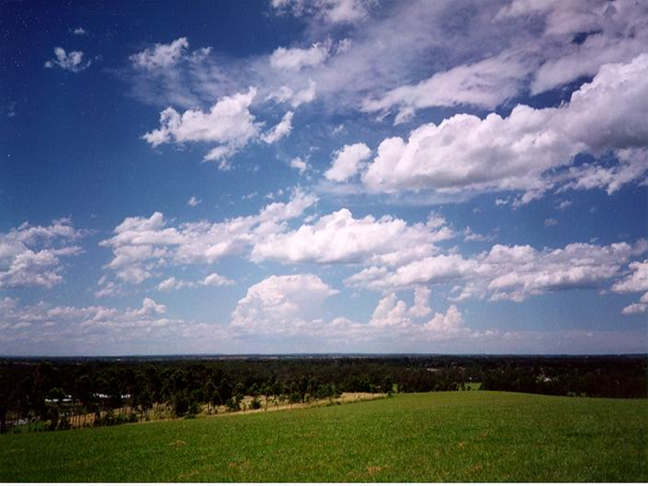
Cumulus
Notes:
Puffy white clouds with flat bases. Unstable air. Usually fair weather but if observed during the morning hours may grow to towering cumulus or cumulonimbus during the afternoons in the summer months. No precipitation.

Slide 42
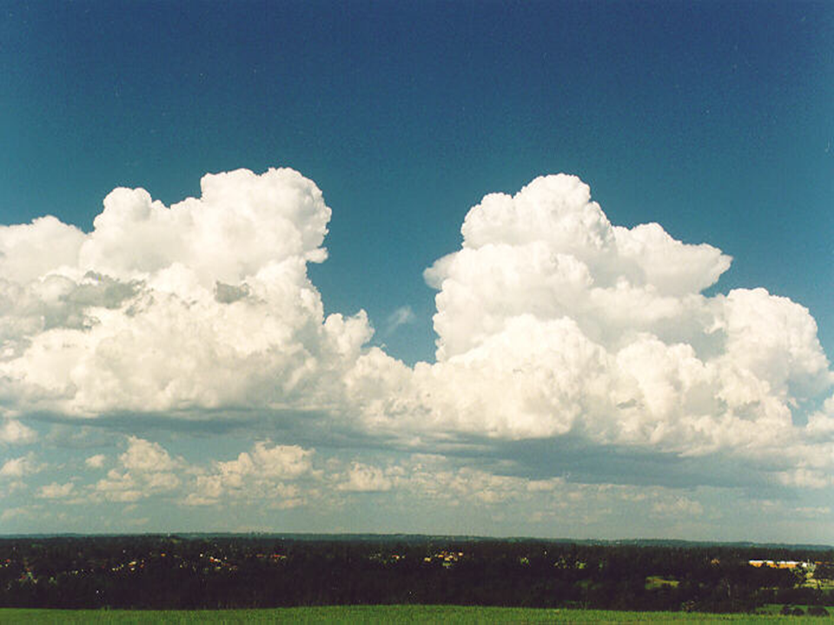
Towering Cumulus
Notes:
Tall cumulus clouds which may be growing, well-rounded, cauliflower-like tops and flat bases. Unstable air. May be frontal, pre or post frontal, with an upper trough or general air mass. Light occasionally moderate showers possible and virga. Downdrafts with gusty erratic winds. May grow into cumulonimbus.

Slide 43
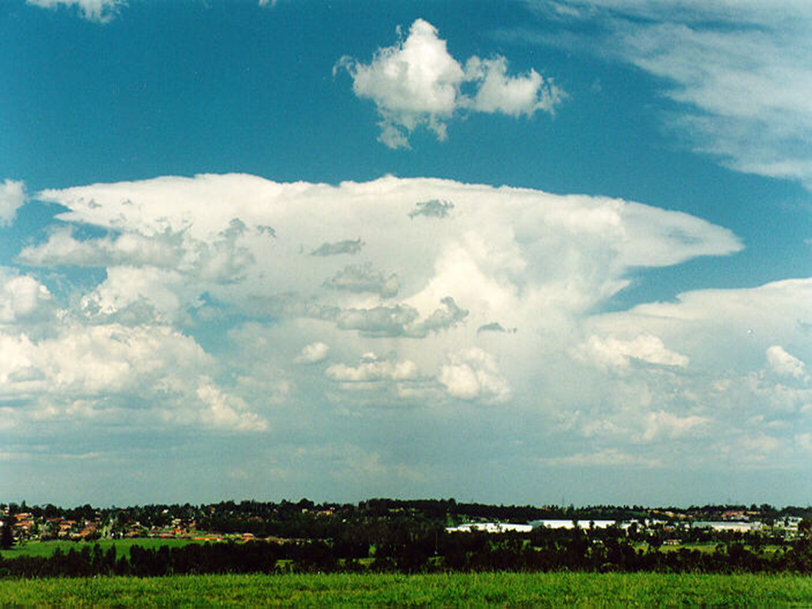
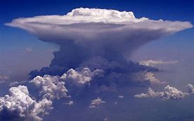
Cumulonimbus Anvil
Notes:
Huge cumulus cloud with flat base and an anvil top. The top may also be in the form of towering cumulus but the edges are becoming fibrous. Very unstable air. Forms along cold fronts, in squall lines preceding a cold front, embedded in warm frontal cloud if the air mass is unstable, with an upper trough or general air mass thunderstorms when enough heating and moisture is available. Showers of light, moderate, heavy or very heavy intensity. Virga, hail, lightning and tornadoes possible. Downdrafts will produce strong, gusty winds from 50 to 90 km/h while microbursts can produce winds gusts as high as 150 km/h. These clouds may develop as individual cells, clumps of cells or a line of cells.

Slide 44
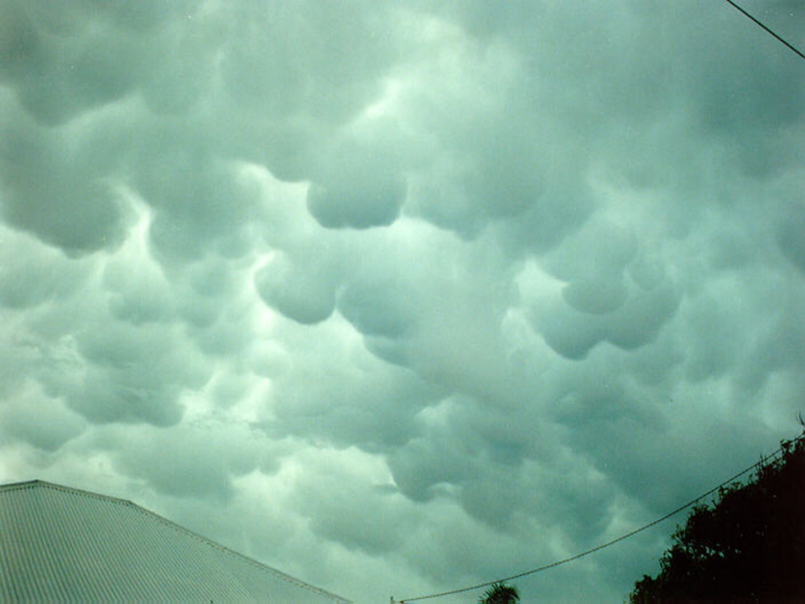
Mammatus
Notes:
Rounded globular masses hanging from the bases of cumulonimbus cloud. The mechanism for their formation is not well known and as been poorly studied. Generally occur during the dissipating stage and is a sign of cool moist air sinking out of the cloud with very dry air beneath. Very unstable air.

Slide 45
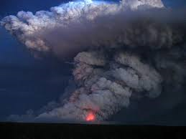
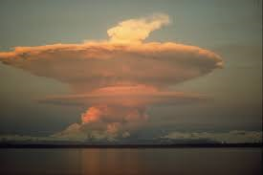
Pyrocumulus
Notes:
Also known as flammagenitus a pyrocumulus cloud is produced by the intense heating of the air from the surface. The intense heat induces convection, which causes the air mass to rise to a point of stability, usually in the presence of moisture. Phenomena such as volcanic eruptions and forest fires can induce formation of this cloud, by mechanisms similar to those that form homogenitus. The presence of a low-level jet stream can enhance its formation

Slide 46
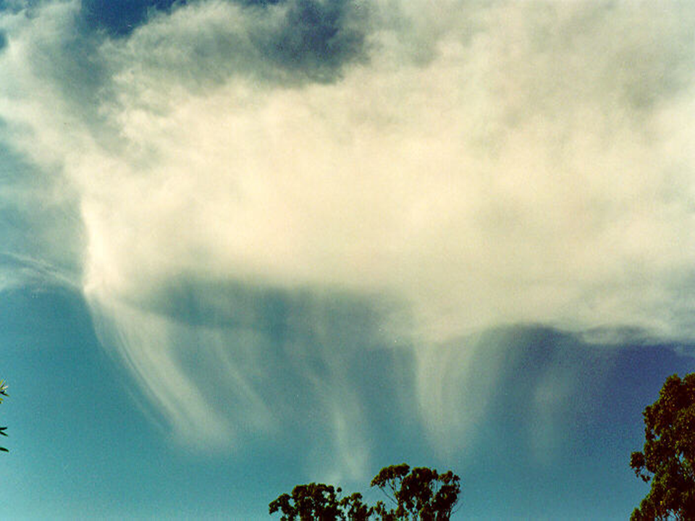
Virga
Notes:
Precipitation falling from cloud but not reaching the ground, it evaporates as it falls. Indicative of very dry air below the cloud.

Slide 47
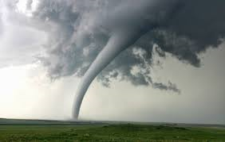
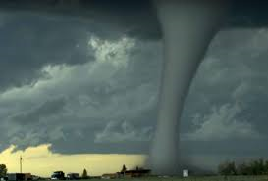
Tornado
Notes:
A violently rotating column of air extending downward from the base of a cumulonimbus cloud and touching the ground. This column is an extremely powerful updraft into the cloud. Wind speeds can be as strong as 116 km/h (f0 tornado) to over 420 km/h (f5 tornado). Updraft wind speeds can reach 300 km/h. Extremely unstable air.

Slide 48
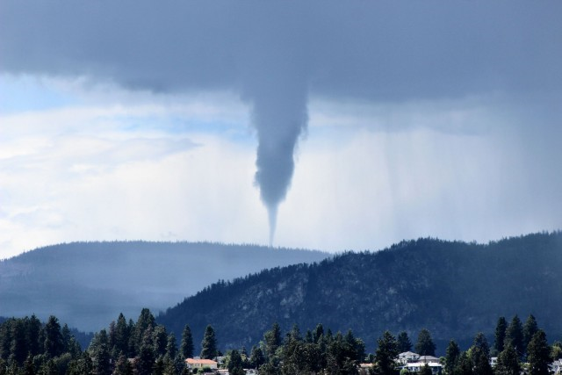
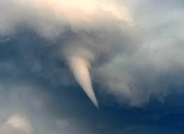
Funnel
Notes:
A violently rotating column of air extending downward from the base of a cumulonimbus cloud, not in contact with the Earth. This is an extremely powerful updraft into the cloud. Extremely unstable air. Can become a tornado.

Slide 49
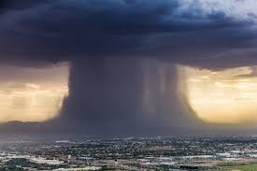
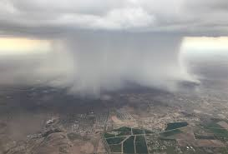
Microburst
Notes:
A very intense downdraft out of a cumulonimbus cloud which spreads out in all directions as it hits the ground. Wind speeds of 100 km/h to greater than 200 km/h can be experienced.

Slide 50

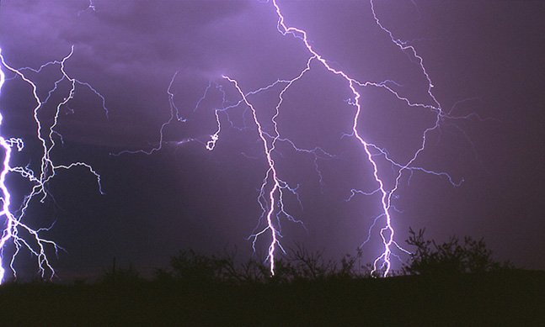
Lightning
Notes:
Can be cloud to cloud, inside cloud and cloud to ground. We are interested in cloud to ground which is a discharge of static electricity from the cloud to the ground. Can be positive or negative. Negative is from near the base of the cloud and positive is from the top of the cloud. Although both types of lightning start fires, positive strikes are generally considered to be more dangerous due to the longer duration of the stroke and it is more likely to strike outside the rain area.

Slide 51
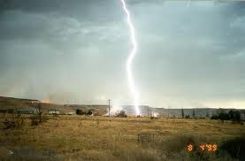
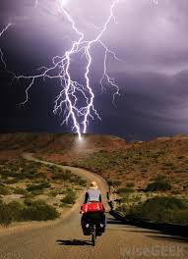
Dry Lightning
Notes:
Dry lightning occurs when there is little or no precipitation from the cloud, or strikes outside the precipitation area.

Slide 52
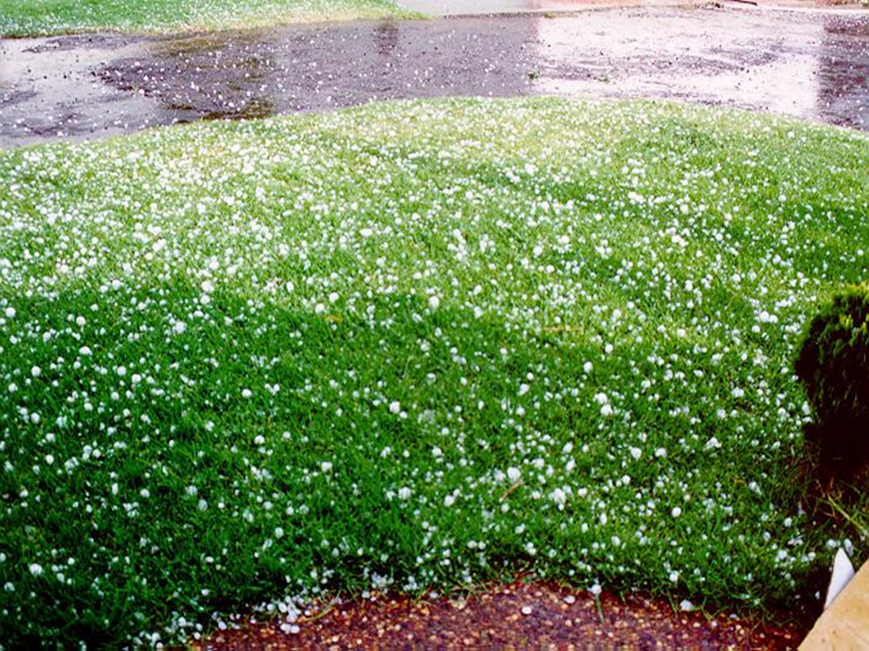
Hail
Notes:
Precipitation in the form of ice falling from cumulonimbus cloud. Indicative of strong updrafts in the cloud. Very unstable air.

Slide 53
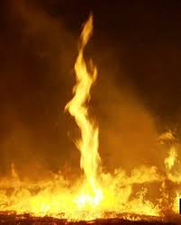
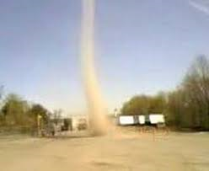
Fire Whirls and Dust Devils
Notes:
Indicators of intense local heating and very unstable air. Updrafts of 40 to 60 km/h can develop with whirlwind speeds of 40 to 90 km/h.

Slide 54
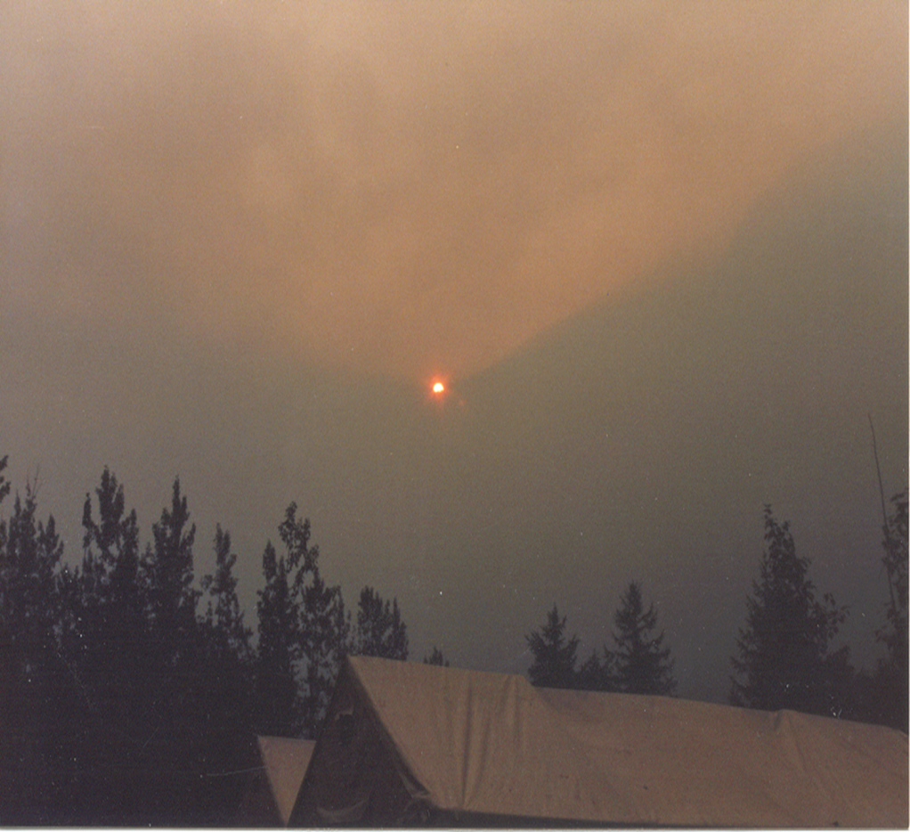
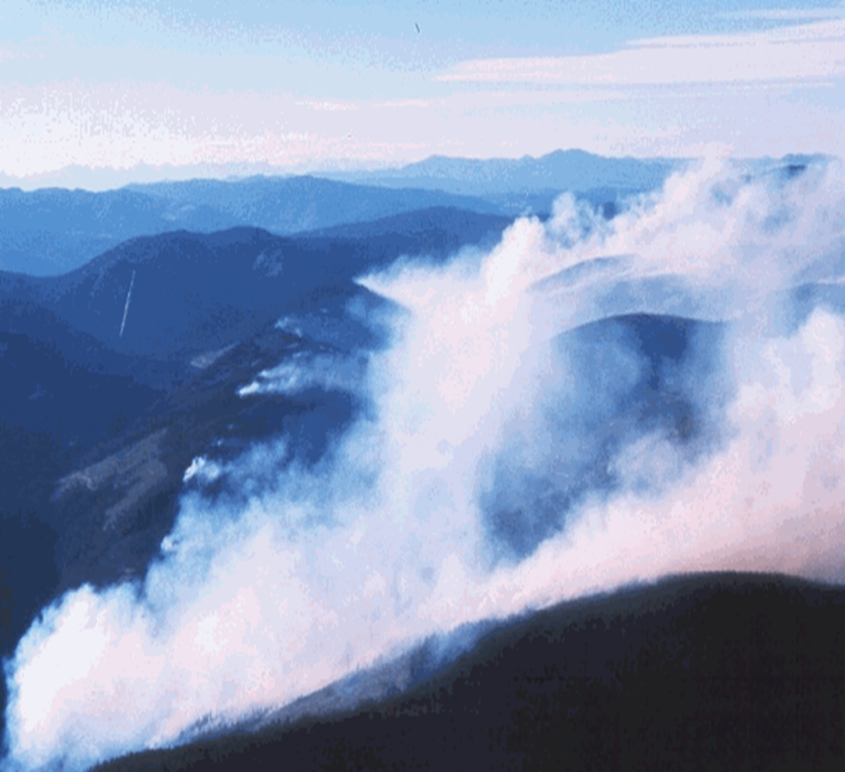
Inversion
Notes:
Warm air over cooler or cold air, traps smoke and pollutants below the inversion. A nocturnal inversion forms due to radiation cooling under clear or mostly clear skies and calm or light winds.

Slide 55
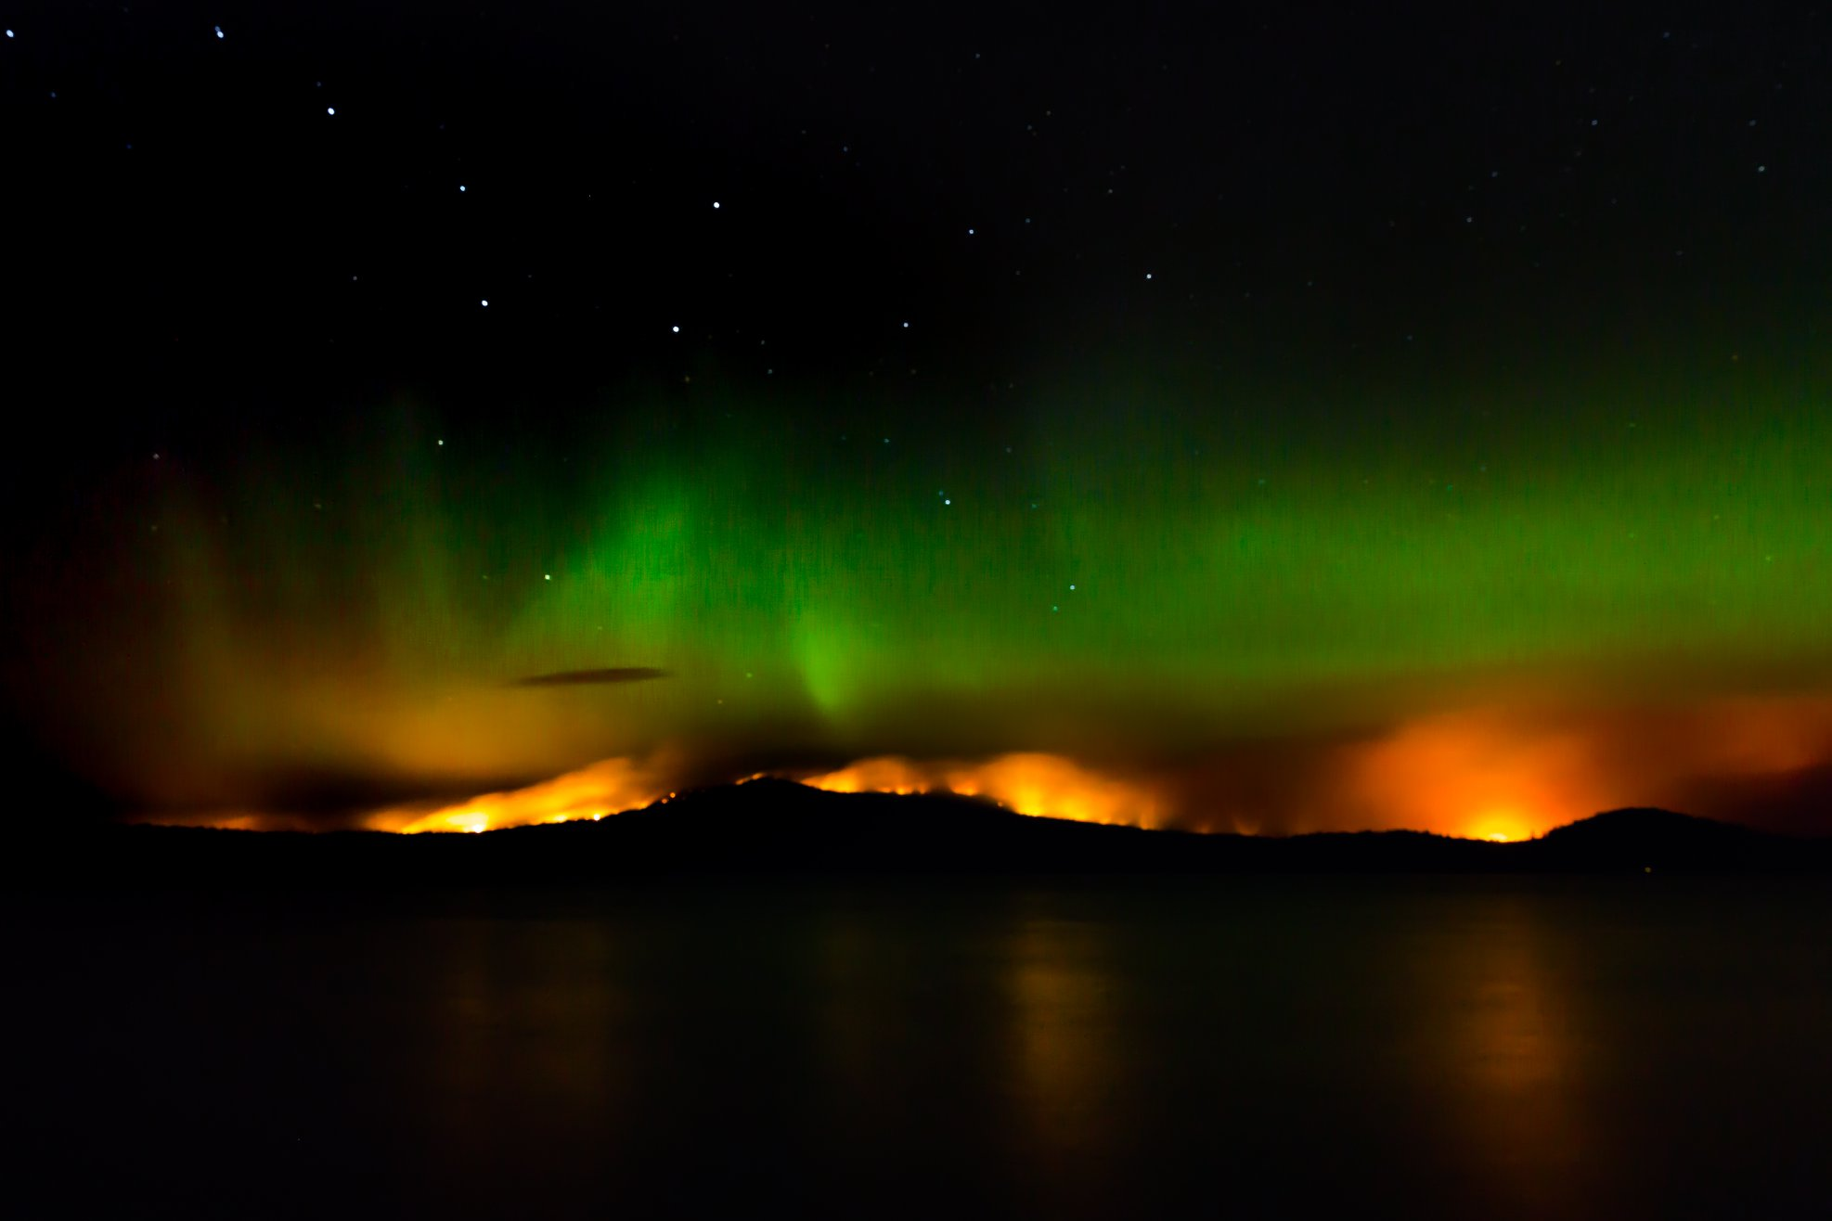
Questions?

Slide 56
S-211 Introduction to Weather & The Fire Environment
For Firefighters and Dispatchers
Part 3

Slide 57
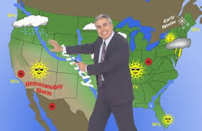
Forecast Terminology
Notes:
Ensure the students know what they will have learned by the end of this course/module

Slide 58
Low Pressure and Trough of Low Pressure
Cloudy, cool, windy, rain or showers, thunderstorm
On the surface chart wind blows counter clockwise around the low and inwards at a slight angle towards the centre
The trough is an elongation of the low

Slide 59
High Pressure and Trough of Low Pressure
Sunny, warm, dry, light winds
On a surface chart wind blows clockwise around the high and outwards at a
slight angle towards a low
The ridge is an elongation of the high

Slide 60
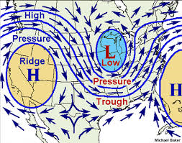
Surface Chart

Slide 61
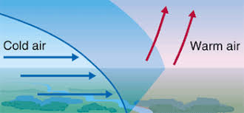
Cold Front
Border between advancing cold air and warm air 45 to 90 km wide
Cloudy and windy with showers or thundershowers
Abrupt wind shift as the front passes, often to the west or northwest
Temperature and relative humidity decrease with the frontal passage

Slide 62
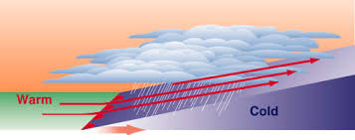
Warm Front
Border between retreating cold air and warm air
150 to 300 km will
Cloudy and windy with rain
Wind shift as the front passes, often to the south or southwest
Temperature and relative humidity increase with the frontal passage

Slide 63
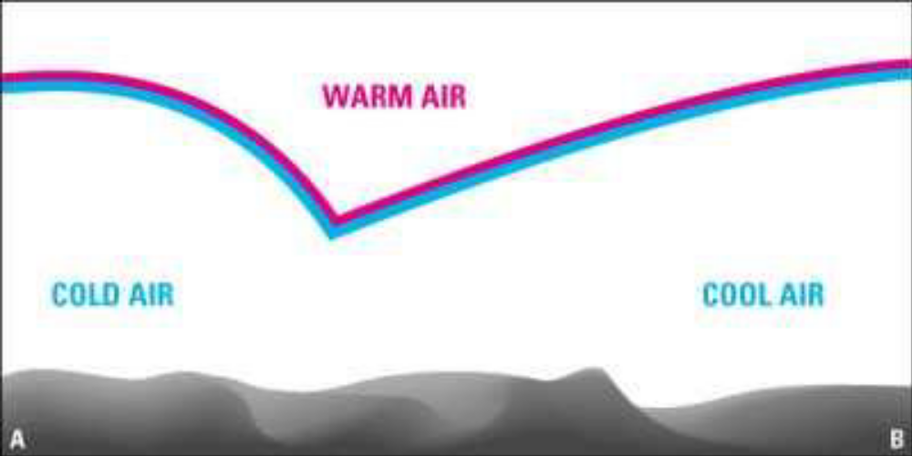
TROWAL
TRough Of Warm Air Aloft
Occurs when a cold front overtakes a warm front
Conditions will be a combination of the weather associated with both a cold front and a warm front.
Notes:
A cold front overtakes a warm front and lifts the warm air off the ground

Slide 64
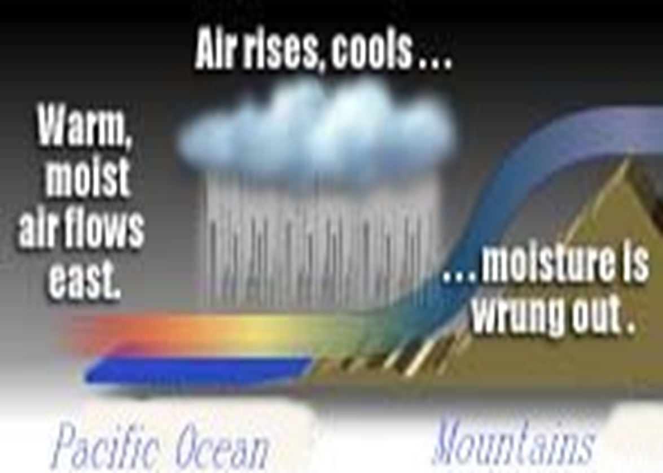
Upslope
Notes:
A predominately westerly flow of air over B.C. with several mountain ranges between the coast and Alberta produces 2 significant weather features in our province, upslope and subsidence. These two conditions affect the amount of cloud and rainfall accumulation, in many areas of B.C.
Windward side of all mountain ranges in BC. Produces large rainfall events as weather systems move across the area. Rainfalls of 20 to 30 mm are common in these areas with 50 to 100 mm rainfalls occurring a few times per season, generally in the spring and fall. The air in the westerly flow is forced upward by the mountain range. As the air is forced up it cools and moisture contained in the air mass is condensed and falls out as precipitation when the air mass is cooled enough to reach saturation.

Slide 65
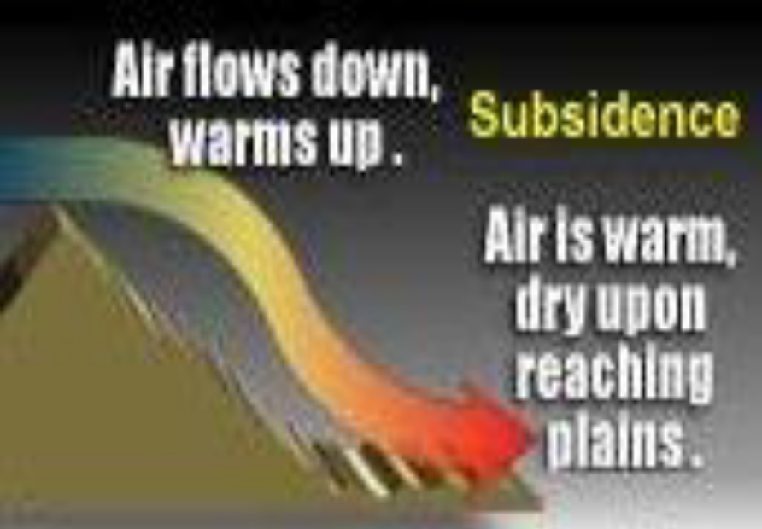

Subsidence
Notes:
Leeward side of all mountain ranges in BC. Dries out weather systems as they move across the area with little or no rainfall experienced, warmer temperatures and more sun than surrounding areas.

Slide 66
Upslope / Subsidence
Upslope and subsidence areas become reversed when a cold low passes to the south of the area or a surface high moves through the southern NWT or northern Alberta. This gives the wind an easterly component, changing upslope areas from western slopes to eastern slopes and subsidence areas from eastern slopes to western slopes.

Slide 67
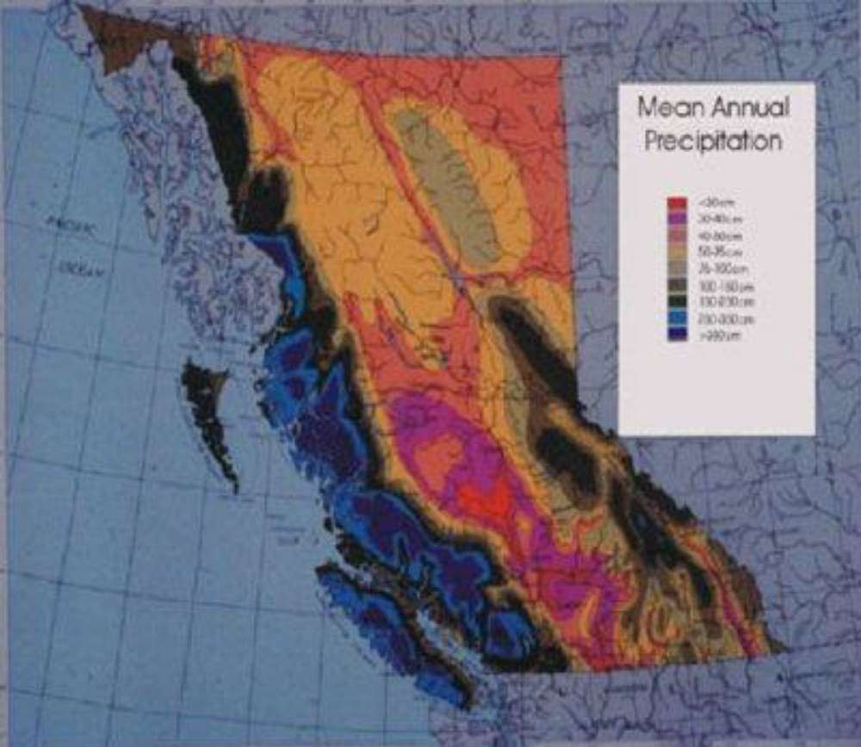
Upslope / Subsidence
Notes:
Looking at the annual average precipitation map for BC we see the upslope and subsident areas well delineated.

Slide 68
Temperature Inversion
Temperature normally decreases with height at 1 C per 100 metres. In a temperature inversion, temperature increases with height.
Types of Inversions:
Nocturnal
Marine
Subsidence

Slide 69

Nocturnal Inversion
Notes:
Nocturnal Temperature Inversions:
Forms at night, due to the settling of the atmosphere.
Readily forms on CLEAR and CALM nights.

Slide 70

Nocturnal Inversion
FIRE BEHAVIOR BECOMES MORE
ACTIVE AND ERRATIC ONCE A
NOCTURNAL INVERSION BREAKS !
Notes:
When the inversion breaks:
Sudden increase in surface temperature.
Sudden decrease in RH.
Sudden increase in wind speed – can be accompanied by a change in wind direction as well.
Thus, quiet fires can rapidly turn into active fires.

Slide 71

Marine Inversion
Forms when cooler, marine air moves over the land

Slide 72
Subsidence Inversion
Subsidence progresses downward from its origins in the upper atmosphere.
As a result, it takes time for the warmest and driest air to reach the surface.

Slide 73

Subsidence Inversion Day 3
Notes:
Subsidence progresses downward from its origins in the upper atmosphere.
Thus, the first areas to receive the warmer and drier conditions will be the upper slopes.
Here, base camp would have a temp of 22, RH of 45% and wind speed of 10.
The fire on the upper slopes would have temp of 27, RH of 30% and winds of 25 km/h.
Wildfires burning on the upper slopes, at or above the level of the subsidence inversion, would experience a totally different fire weather regime than a fire out on the lower slopes or plains area.

Slide 74

Subsidence Inversion Day 5
Notes:
Fires burning at elevations below the subsidence inversion will generally exhibit less extreme/severe fire behavior than fires burning at or above the level of the subsidence inversion.
Suppression teams need to take great care when battling a wildfire at upper elevations during a strong ridging scenario…especially during the first few days of a “new” upper ridge when the very warm/dry air is still sinking to the surface.

Slide 75

Subsidence Inversion Day 7

Slide 76
Thermal Belt
Has the highest overnight temperature, the lowest overnight relative humidity
and stronger overnight winds.
Fires burning in the thermal belt remain more active overnight!

Slide 77

Thermal Belt
Notes:
Below the thermal belt:
• Conditions are “stable”.
• Lighter winds, lower temperatures, higher RH values.
• Predictable fire behaviour.
At the thermal belt:
• Conditions abruptly change from stable to unstable; from cooler to warmer; from higher RH to lower; from light winds to gustier.
• Promotes a change in fire behaviour.
Above the thermal belt:
• Air mass more unstable.
• Lower temperatures, higher RH.
• Often stronger (or erratic) winds.
• Fire behaviour sometimes less predictable.

Slide 78

Thermal Trough
Notes:
Strong heating in the southwestern US will develop a thermal trough northwards into southern BC either into the south interior or along or off the coast. The thermal trough enhances warming and drying. Effects developed by this trough include warmer temperatures (2 to 8 degrees Celsius depending on the time of year), lower humidity's (10 to 20%) and inflow or outflow winds.
A trough into the interior produces light inflows overnight until mid morning, then moderate to very strong inflows from mid mornings through mid evenings as temperatures increase in the interior.
A trough along or off the coast produces moderate to strong outflows overnight and in the early morning hours then reverses to light to moderate inflows from late mornings through early evenings with strong heating from the Interior.

Slide 79

Subtropical Moisture
Notes:
Sub-tropical moisture (sometimes referred to as monsoonal moisture) approaches BC from the southwest, south or southeast and has a source region of the South Pacific or Mexico. This air is very moist, usually in the mid to high levels and approaches in bands or patches. With strong daytime heating in southern BC sub-tropical moisture can explode into moderate to severe dry lightning storms, developing from mid afternoons onwards and occasionally persisting through the overnight period. Two patterns signal the possible approach of sub-tropical moisture. The first sees a strong upper ridge over eastern BC or Alberta with a deep upper trough off the BC/US coast producing a southwest to south flow of air into southern BC. The second sees a strong upper level ridge of high pressure over the province with a cold low off the California coast (High/Low Block) producing a south to southeast flow of air into southern BC.
The southwest to south flow of air usually confines dry lightning outbreaks to the south interior while a south to southeast flow of air will also see dry lightning develop over south coastal areas.

Slide 80
Cold Low
Generally cloudy, unseasonably cool, windy and very wet.
Timing and intensity and movement of these systems are variable and unpredictable.

Slide 81

Wind
Notes:
Wind, although often driven by large scale synoptic high and low pressure systems, in British Columbia is significantly affected by local effects, such as mountainous terrain, and in some areas synoptic winds may never be experienced. Some of the many variables we have to take into consideration when determining wind speed and direction are the coastline, mountain ranges, valleys, heating and cooling in addition to pressure gradient and frontal systems. The coastline, mountain ranges and valleys control wind direction in BC while the pressure gradient, temperature differential and valley shape control the wind speed.

Slide 82

Wind
Notes:
Wind, with a barrier in its path, will alter direction and flow parallel to the barrier unless the flow is strong enough to force the air over the barrier.

Slide 83

Wind - Channeling
Notes:
Wind direction follows the shape of the valley

Slide 84

Wind - Upvalley / Upslope
Notes:
Develop during the morning hours and last through early to mid evening, strongest during the afternoon and early evening. Upslope winds begin on eastern slopes first as temperatures rise, up-valley winds begin later in the morning to early afternoon as the whole volume of air in the valley is warmed. Winds can reach speeds of 20 to 30 km/h.

Slide 85

Wind – Downvalley / Downslope
Notes:
Develop during the evening and last into the morning as temperatures decrease and cold air begins draining into the valleys, usually a light wind of 5 to 15 km/h.

Slide 86

Wind – Sea or Lake Breeze - Day
Notes:
Water temperature varies little from night to day while land temperatures see significant diurnal changes. During the day the land temperature will be many degrees warmer than nearby water temperatures of the ocean or large lakes, this will develop an onshore flow of air which can reach speeds of 10 to 20 km/h during the late afternoons with local gusts to 30 km/h. Air over the land is heated faster than air over the water and as it rises the air over the water moves onshore to fill the void left by the rising air.

Slide 87

Wind – Land Breeze - Night
Notes:
Land temperatures cool significantly overnight and can end up lower than nearby ocean or large lake water temperatures, developing an offshore flow of air in the 5 to 10 km/h range. This is the reverse process of the daytime sea breeze.

Slide 88

Wind – Valley Funnel Effect
Strongest wind in funnel exit region due to acceleration
Notes:
Winds increase as they are forced into narrow areas of valleys and decrease as they flow into wider areas. Wind speeds can double or triple in speed under these conditions.

Slide 89

Wind – Thermal Effect
Notes:
Intense heating in the interior of BC will see a deep mixing layer develop, which will bring high level winds to the surface as gusts during the afternoons. In mountainous terrain winds from 3,000 metres will reach the surface on a strong convective day.

Slide 90

Wind - Inflow
Notes:
Through inlets and valleys, develops with a ridge of high pressure along the coast and a trough of low pressure or low in the interior. The wind speed is dependent on the pressure gradient and temperature. Overnight inflows tend to be light, 5 to 10 km/h, strengthening through the day as temperatures increase with speeds from 10 to 20 km/h common and 20 to 30 km/h not unusual.

Slide 91

Wind - Outflow
Notes:
Through inlets and valleys, develops with a trough of low pressure or low along or off the coast and a ridge of high pressure or a high over the Interior. The wind speed is dependent on pressure gradient and temperature. During the day winds will tend to be light, 5 to 10 km/h, increasing to moderate outflows, 20 to 30 km/h by late evening into the early to mid morning when they will again become light. A deep low pressure system approaching the coast can produce outflow gusts from 60 to 100 km/h through some valleys and inlets. Strong heating in the interior will shift outflow winds to light to moderate inflows during the afternoon. Outflow winds will also develop warmer than normal temperatures and lower relative humidity's in mainland inlets and valleys.

Slide 92

Wind - Glaciers
Notes:
Downslope day and night, undercuts the up-valley/upslope wind. Speeds of 10 to 20 km/h are common with stronger gusts associated. Bursts from 60 to 100 km/h are possible in the deeper and narrower ravines and canyons.

Slide 93


Wind - Eddies
Notes:
Over hills and mountains and at valley intersections and bends. They cause erratic directional and speed changes.

Slide 94

Wind - Downdrafts
Notes:
Downdrafts develop beneath the bases of towering cumulus clouds and cumulonimbus clouds. Gusts from 40 to 60 km/h can be experienced near towering cumulus clouds while gusts from 60 to 80 km/h can be experienced near cumulonimbus clouds.

Slide 95

Wind – Low Level Jet
Low Level Jet
Notes:
A narrow band or stream (sometimes called a tube) of strong, low level winds. These winds can vary from 40 to over 100 km/h. Two types of low level jets occur. The first is a night-time phenomena and occurs near the top of an inversion. It forms near or shortly after sunset and breaks up when the inversion dissipates. The second occurs between 1500 and 4000 metres associated with upper troughs and cold fronts.

Slide 96

Questions?

Slide 97
S-211 Introduction to Weather & The Fire Environment
For Firefighters and Dispatchers
Part 4

Slide 98

Fire Weather Forecasts
Notes:
The Fire Weather forecast is an extremely valuable decision planning aid used by the BC Forest Service. The forecast consists of several sections:

Slide 99
Fire Weather Forecast
Synopsis - short description of weather systems affecting the area of interest, their strength, track and speed. Air mass descriptors will also be included in this section.
Today - detailed forecast of clouds, wind, temperature, humidity and precipitation.
Tonight - as above.
Tomorrow - as above.
3 to 5 day - forecast of weather systems, cloud, wind, temperature, humidity and precipitation, although not as detailed as the today, tonight and tomorrow section.
6 to 10 day - general forecast of weather systems and trends.

Slide 100
Fire Weather Forecast
Venting Outlook - Detailed forecast for today indicating the smoke dispersal conditions. Includes the top of the inversion, if any, the inversion breakthrough temperature and the timing of the breakthrough. Plume drift characteristics.
4 day – A more general forecast for day 2 through day 5. Venting
Winds Aloft - Upper level wind speeds and directions for 3 general levels, below 1000 metres, above 1000 metres and above 2500 metres.
Confidence -Good/Fair/Poor/ - how the forecaster feels about the forecast. Confidence in the computer analyses and prognoses. This could be a simple or detailed statement.

Slide 101

Spot Forecast
Notes:
The spot forecast is a more detailed site-specific forecast for decision planning on active fires and for planned burns. This forecast can be tailored to the requirements of the person requesting the forecast. The forecaster will need information from the crew on site or on the planned site to prepare this forecast. This information includes the fire name and number, location (lat./long.), elevation, aspect, slope, valley orientation and the latest weather readings from on site or from a representative site. As it is not always possible to provide all this information immediately, the minimum required information from the site would be the fire name and number, location and the elevation. The remainder of the information will be forwarded to the forecaster as soon as possible.

Slide 102

Spot Forecast
Requests for spot forecasts are made through dispatch and approved by the RWCO.

Slide 103
Spot Forecast
When placing a request for a spot forecast be prepared to relay the following information to dispatch:
Fire Number
Location – Latitude and Longitude
Elevation – metres or feet
Aspect
Slope
Valley Orientation
Local Weather – Temp/Humidity/Wind

Slide 104

Spot Forecast
Notes:
This example indicates the forecast would be for 1 PM and would include the maximum temperature, wind and minimum relative humidity. However, this is only a basic template and if forecast data were required for other time periods or 2 or 3 elevations it would also be included in the spot forecast. A section would also be added if any significant weather were expected to develop.
A final area of the form is left for feedback and comments from the crew, this will enable the forecaster to fine tune the forecast for your site.

Slide 105
Weather Warnings & Advisories
Are sent out when significant changes to the weather forecast are indicated. They would include thunderstorms, lightning, wind, heavy precipitation and hail, conditions which would pose a serious threat to life and/or property.
Advisories are issued when conditions indicate the potential for a significant weather event.
Warnings are issued when a definite severe weather event is forecast to take place.
Weather warnings and advisories are very detailed forecasts indicating the intensity and timing of the severe weather event.

Slide 106

Weather Warnings & Advisories

Slide 107

When Things Change

Slide 108
When Things Change
Fire Behaviour Triangle
Weather
Topography
Forest Fuels
Notes:
Firefighting is normally a challenging but reasonably safe occupation. However, problems do occur and most of these can be linked to changes in the Fire Environment.
These changes include:
• Fuel type changes - predictable
• Topography changes - predictable
• Weather changes - predictable but also variable - hourly, daily, weekly and seasonally

Slide 109
When Things Change
Wind shifts - cause the fire to run back towards the firefighters on the flanks and in the rear of the fire.
Upslope/downslope winds shift 180 degrees as the atmosphere warms up or cools down
Upslope winds develop from mid morning through to early afternoon.
Downslope winds develop from early to late evening.
Subsidence will shift winds 180 degrees to downslope winds during the day when upslope winds normally occur.
Sea or lake breezes, onshore or offshore shift 180 degrees as the atmosphere warms up or cools down.
Onshore breezes develop as the land becomes warmer than the water during the late morning and early afternoon.
Offshore breezes develop as the land cools during the evening.

Slide 110
When Things Change
Frontal passages cause abrupt wind shifts from 45 to 180 degrees as they move through an area. The degree of shift depends on your location. In open areas wind shifts tend to be 45 to 90 degrees. In valleys wind shifts tend to be 180 degrees.
A trough of low pressure will cause winds to shift through 180 degrees as it crosses the area.
Thunderstorms moving across an area will produce erratic wind shifts.

Slide 111
When Things Change
Wind Increases - causes the fire to overrun the firefighters near the head of the fire.
Daytime heating will cause winds to increase in strength as a deep mixing layer develops and higher levels winds are forced to the surface. These winds will tend to be gusty and erratic in nature.
Subsidence will cause light to moderate and occasionally strong downslope winds to develop.
Frontal systems and troughs of low pressure bring increasing winds to the area as they approach.
Thunderstorms bring strong and erratic wind increases.

Slide 112
When Things Change
Temperature changes - These occur as weather systems change and through normal diurnal heating and cooling. They are a cause of hypothermia and dehydration. Systems which will bring about these changes include:
Cold frontal passages will normally develop a sudden drop in temperatures, as much as 10 degrees.
Cold lows will develop a gradual to fast cooling of the atmosphere as it approaches, as much as 15 to 20 degrees.
Thermal troughs will increase temperatures by as much as 8 degrees.
Thunderstorms can bring significant localized cooling with their downdrafts as they move through an area. This cooling tends to be short-lived unless associated with a frontal passage or cold low or late in the day.
A temperature inversion will produce a thermal layer on the slopes above the valley floor where temperatures will remain warm through the night and fire can remain active.
Subsidence will produce several degrees of warming which will last through the night.

Slide 113
When Things Change
Relative humidity changes - These occur as weather systems change and through normal diurnal heating and cooling. Low relative humidity’s are a cause of aggressive fire behaviour while higher relative humidity’s will bring a decrease in fire activity.

Slide 114
When Things Change
Systems which will develop these changes include:
Subsidence will bring a decrease in the relative humidity during the day when low humidity’s are common and at night when we would normally expect a significant increase in the relative humidity.
A thermal trough will bring decreasing relative humidity’s, as much as 10 to 20%.
A temperature inversion will produce a thermal layer on the slopes above the valley floor where relative humidity’s will remain low through the night and fire can remain active.
Warm fronts, cold lows and troughs of low pressure normally bring increasing relative humidity’s.
Cold fronts normally bring lower relative humidity’s.

Slide 115
When Things Change
Thunderstorms Develop - These changes can be brief or prolonged depending on the weather system the thunderstorm is associated with. Thunderstorm changes tend to be very abrupt and significant.
Abrupt and erratic wind shifts. The wind flows outward from the thunderstorm cell.
Sudden and strong increase in wind speed. Winds will have strong gusts associated. Speeds from 40 to 80 km/h are common.
Potential for microbursts, a sudden and extremely strong downdraft from the thunderstorm cell with speeds in excess of 100 km/h.
Strong cooling.
Significant increase in relative humidity.
Moderate to heavy rain or snow, hail.
Lightning

Slide 116
When Things Change
SIGNALS OF IMPENDING CHANGE
There are many tools and indicators available to the Firefighter to enable the prediction of change in the fire environment.
The forecast will mention approaching frontal systems, troughs, subtropical moisture, potential for thunderstorm development, formation of low level jets, thermal troughs, etc.
Forecast updates, amendments, advisories and warnings will keep you up-to-date on any significant systems that may be changing in intensity or developing.
Cloud types and cloud changes will signal approaching frontal systems, troughs, cold lows and will also alert you to the development of thunderstorms.
Smoke plumes will give an indication of the high level winds and with the right environment the lowering of these winds to the surface.
Change in fuel type can effect a change in fire spread rate and the fire intensity.
Change in topography can effect a change in the fire spread rate and the fire intensity.

Slide 117

Weather Instruments

Slide 118

Thermometers
Sling Psychrometer
Notes:
Wet Bulb - Measures the evaporative air temperature in degrees and tenths of degrees Celsius.
Dry Bulb – Measures air temperature in degrees and tenths of degrees Celsius.
The difference between the dry bulb and wet bulb thermometers is used to calculate the relative humidity.

Slide 119

Wind Gauges
Notes:
Measures the wind speed in kilometres per hour. May read in other units but must be converted back to km/h.

Slide 120

Rain Gauges
Notes:
Measures rainfall in millimetres and tenths of millimetres.

Slide 121

Automatic Weather Station
Notes:
Automatically measures temperature, relative humidity, wind speed and direction and rainfall accumulation hourly and stores the data. The station can be called by radio or telephone and the data downloaded to a central computer.

Slide 122

Questions?
Notes:
Next we will work through a scenario that allows students to work more closely with the FA form so you may want to have students hold any questions related to the FA until after that.

Slide 123
S-211 Introduction to Weather & The Fire Environment
For Firefighters and Dispatchers
Part 5 Case Study

Slide 124

Spot Forecast – August 29, 1996

Slide 125

Stein Fire
Notes:
The Stein Fire was discovered at 3:00 pm on August 1, 1996 at 20+ hectares. Firefighting crews were dispatched and air tanker action was initiated. After discussions with B.C. Parks it was decided to let the fire burn and to monitor. The fire spread slowly during the next few weeks and caused no problems. During the last week of August, after a prolonged dry spell the fire intensity increased and firefighter crews were again dispatched to the head end of the fire. August 30th saw an approaching cold front and associated low level jet. An account of the action on this day follows.

Slide 126

Stein Fire

Slide 127

Fire Weather Forecast
August 29 AM

Slide 128

Spot Forecast –Afternoon Update

Slide 129

Fire Weather Forecast
August 29 PM Update

Slide 130

Spot Forecast – August 30

Slide 131

Fire Weather Forecast
August 30 AM

Slide 132

Weather Advisory
August 30

Slide 133
Stein Fire
An examination of Thursday’s forecasts indicates that although an upper trough and front were forecast for the next day, winds were expected to remain in the moderate range, southwesterly 20 to 30 km/h with the approach of the front, then shift to northerly 20 to 30 km/h with the frontal passage, and finally shift back to southwesterly 20 km/h about two hours after the frontal passage.
Fridays forecasts started off very similar but changed dramatically as more information became available.
The spot forecast issued at 7:00 am indicated southwest winds 20 km/h shifting to north with the frontal passage for a short period then back to southwest. Gusts were forecast from 40 to 50 km/h. It would still be a manageable situation, but one that would need caution during the frontal passage.

Slide 134
Stein Fire
The morning forecast, issued at 8:15 am, had several changes. It shows the addition of a low level jet to the synoptic picture and a stronger cold front than first analyzed. General winds are now forecast to be 40 to 60 km/h. A wind shift is still forecast, but the directions in the general forecast do not match the spot forecast. This is quite common and not a concern; the spot forecast wind directions remain valid. Thunderstorms are forecast to develop along the front.
The Weather Advisory and Red Flag Warning (now called a Fire Behaviour Warning) were issued at 8:30 am. Further analysis of the situation has increased forecast wind speeds from 40 to 60 km/h with gusts to 80 km/h with and behind the frontal passage. A major wind shift will accompany the front. A band of thunderstorms lies along the front.
Decisions based on the Forecasts?

Slide 135
Stein Fire – Morning August 30, 1996
08:30 am -Crews to the fire
09:30 am -Crews were ordered evacuated from the site to safe areas.
-Aircraft were ordered to land and hold.
10:30 am -All crews were in safe areas and aircraft were on the ground.
11:00 am -Frontal passage at the fire.
11:30 am -Crews and aircraft become operational.
An observer near the fire reported the frontal passage at approximately 11:00 am. His report of conditions during and following the passage were very close to forecast conditions. Increasing southwesterly winds at 30 to 40 km/h shifted into the north with the front and increased to 40 to 60 km/h with peak gusts to 80 km/h. The winds tapered off to 20 to 30 km/h approximately 1/2 hour after the frontal passage and shifted back into the southwest. Thunderstorms did accompany the front.
Conditions on the fire became chaotic with the frontal passage. The strong winds created fire whirls, flying debris and also blew down several trees. The observer indicated that at least 2 crews would have been in imminent danger had they remained on the fire.

Slide 136

Questions?

